Slide 1
PSTU Result and Enrollment Automation System Using Django Framework and MySQL
Supervised By
Golam Md. Muradul Bashir
Professor
Department of Computer and Communication Engineering
Faculty of Computer Science and Engineering
Presented By
Md. Tasnif Rahman [1802014]
Mehedi Hasan Rabbi [1802052]

Slide 2
PSTU Result and Enrollment Automation
Front End
HTML
CSS
Bootstrap
JavaScripts
Back End
Django (Python Web Framework)
MySQL (Database)

Slide 3
In our project we have four sections
1. Super Admin
2. Faculty Admin
3. Teacher Section
4. Student Section

Slide 4
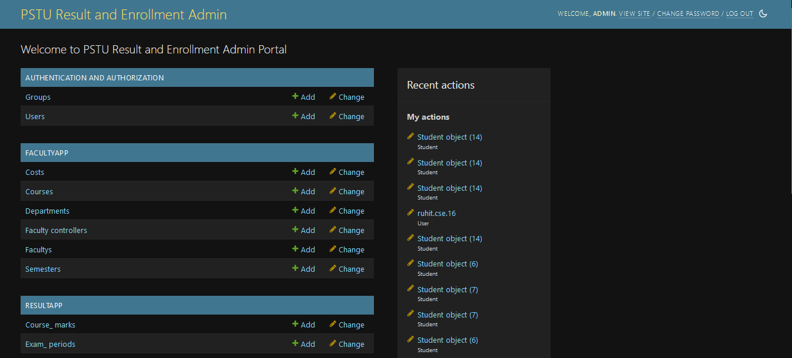
Admin Dashboard

Slide 5
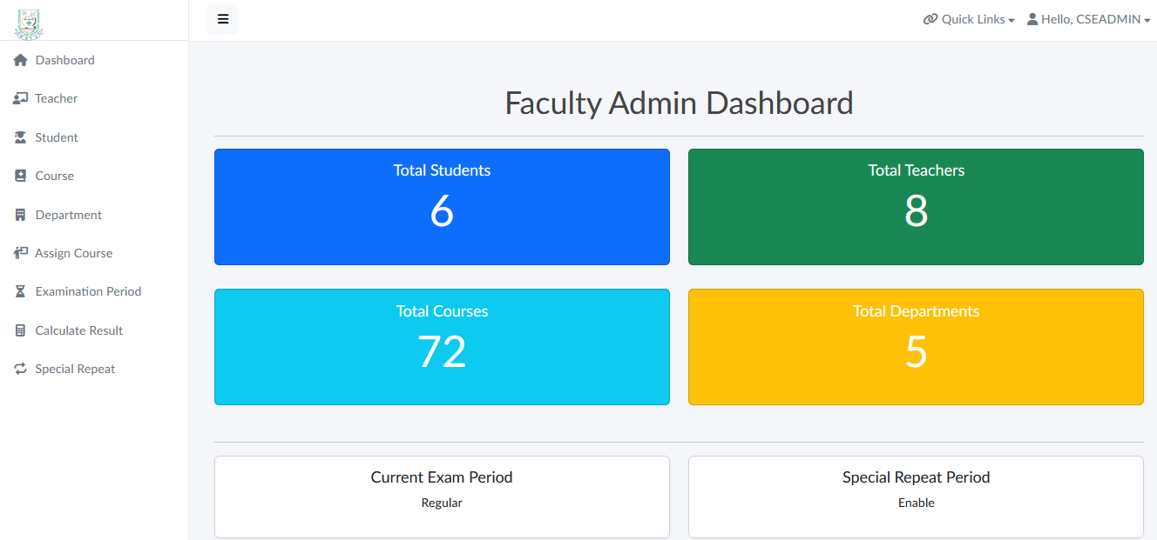
Faculty Admin Dashboard

Slide 6
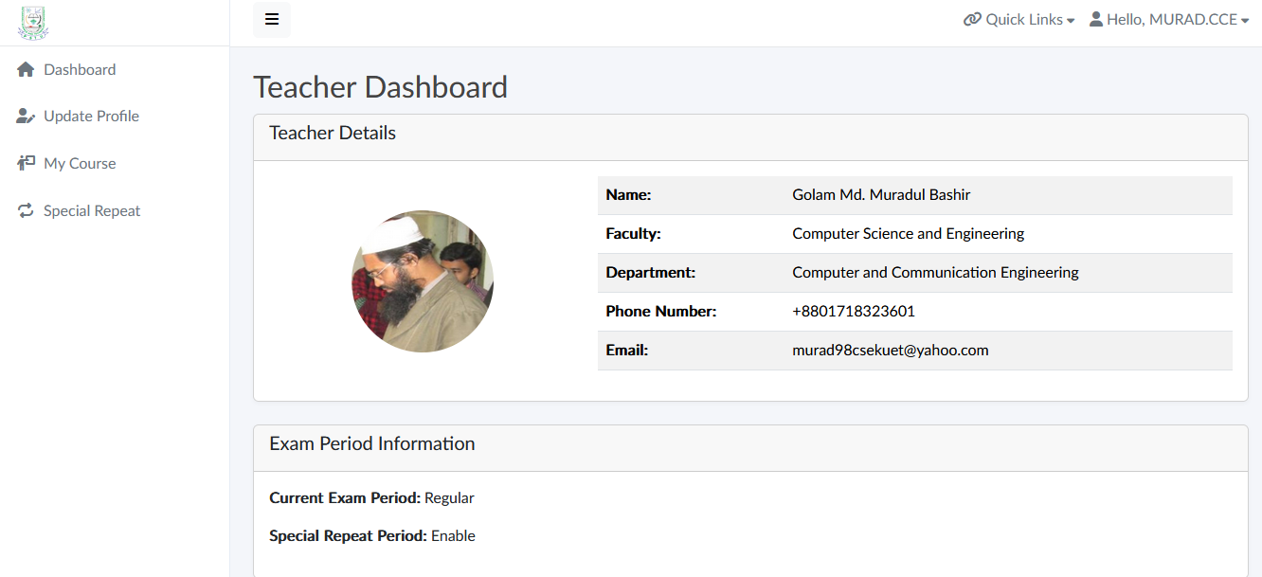
Teacher Dashboard

Slide 7
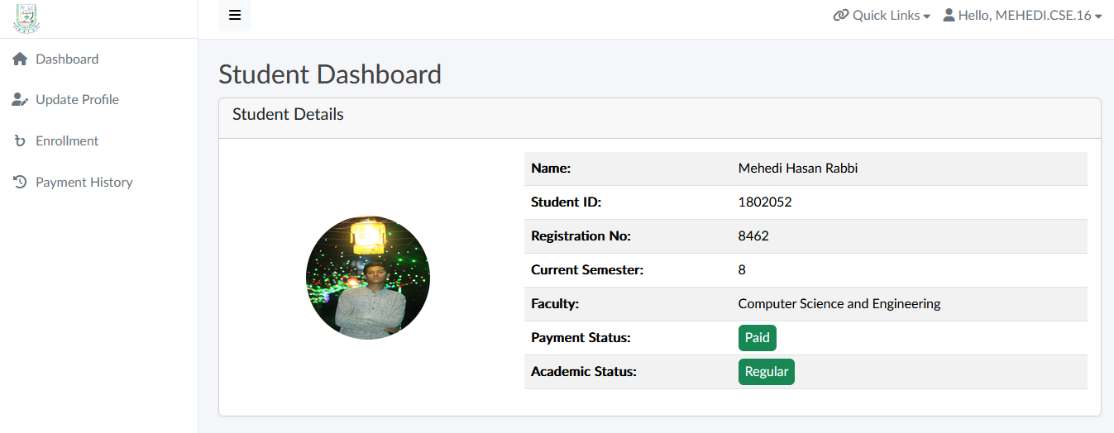
Student Dashboard

Slide 8
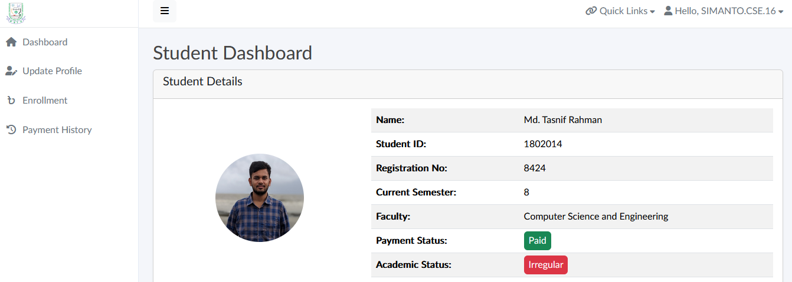
Student Dashboard

Slide 9
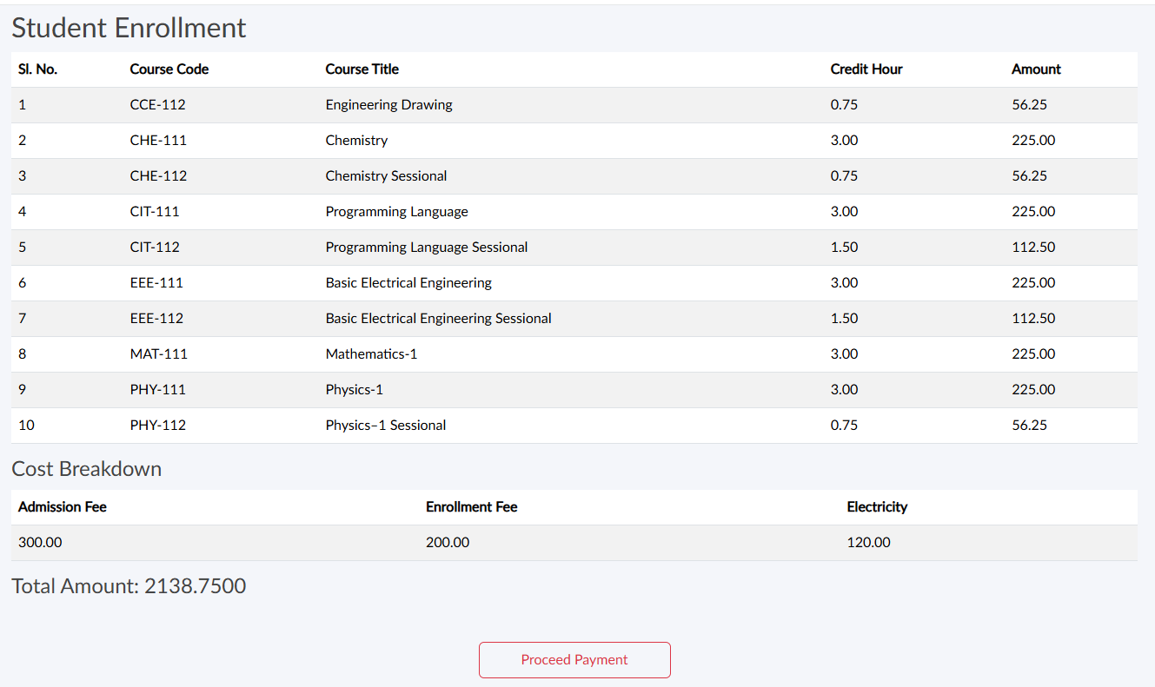
Enrollment Process

Slide 10
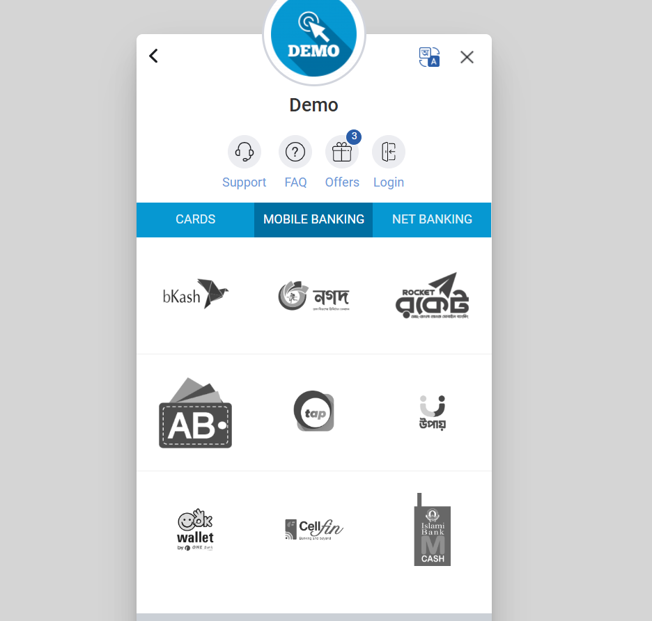
SSLCOMMERZ

Slide 11
Academic Progress Rules and their implementation in our system

Slide 12
Overall conditions
Pass Condition:
1
GPA ≥ 2.000 and CGPA ≥ 2.250 without any F grade.
For the first semester: GPA ≥ 2.000.
Conditional Pass:
2
GPA ≥ 2.000 and CGPA ≥ 2.250.
F grades in a maximum of 50% of the semester's courses.
Considered to be promoted to higher semester:
3
A student with up to 2 F grades will be promoted to the next semester.

Slide 13
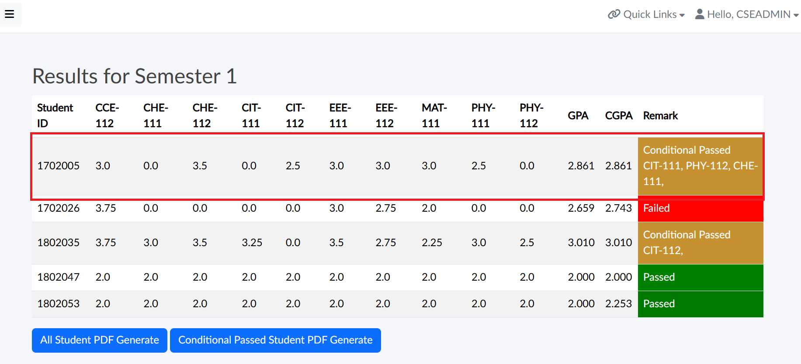
Regular Period: Semester Result (Full passed and max 50% F-grade – Clause: 18.1.1 and 18.1.2 )

Slide 14
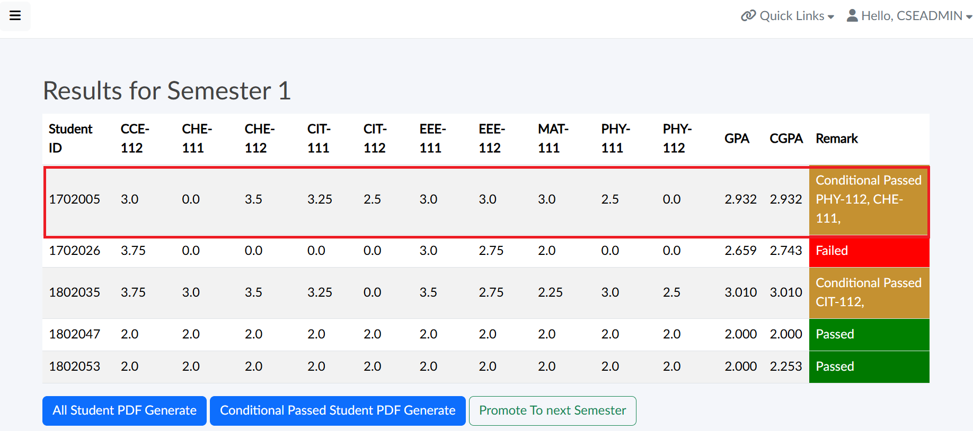
F-Removal Period: Maximum two F-grade Condition – (Clause: 18.1.3 and 18.1.4 ) – Example: 2 F-grade

Slide 15
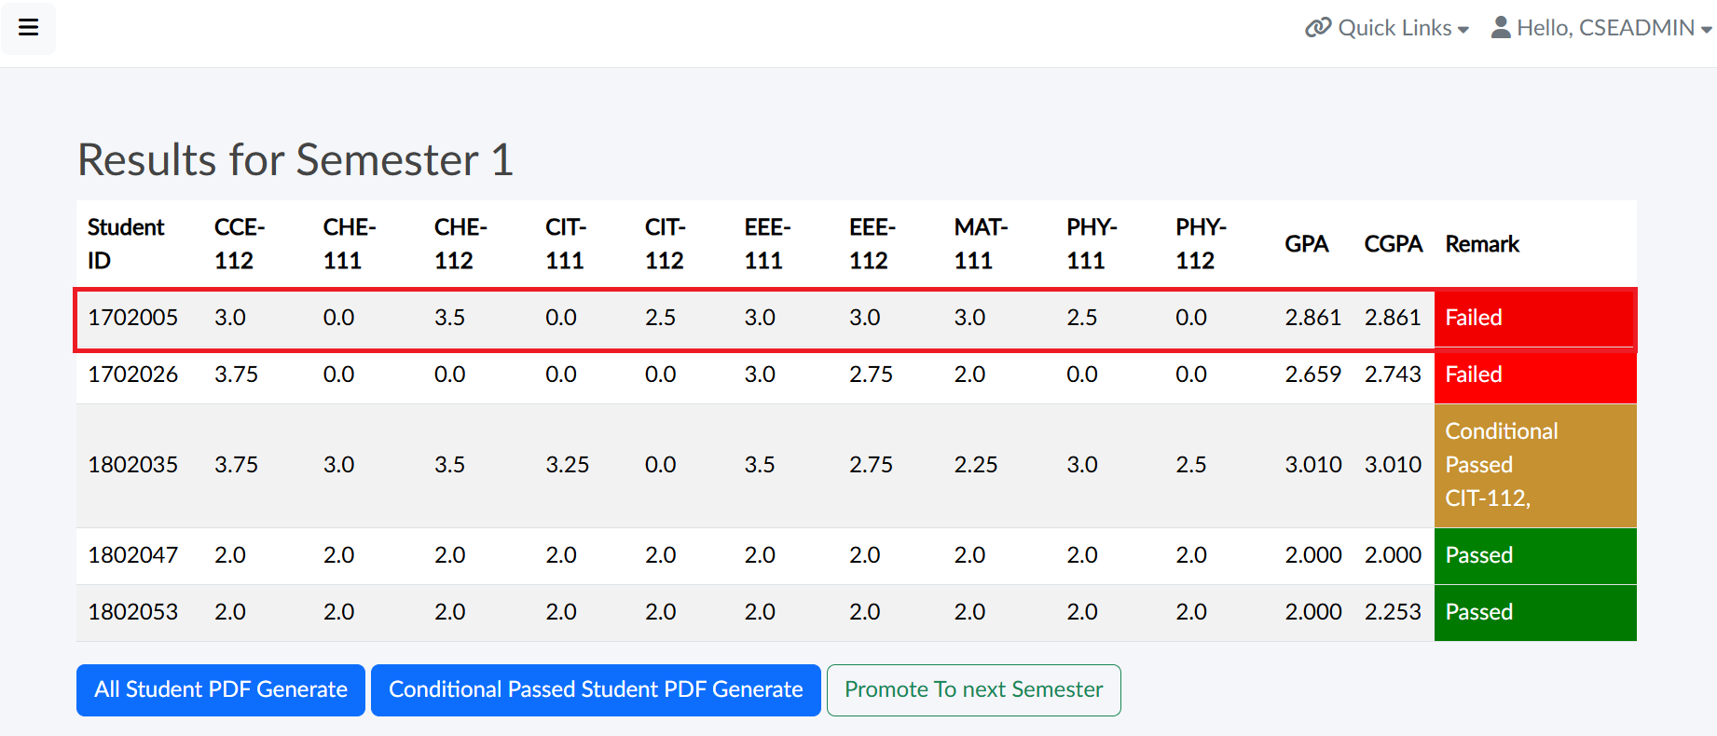
F-Removal Period: Maximum two F-grade Condition – (Clause: 18.1.3 and 18.1.4 ) – Example: 3 F-grade

Slide 16
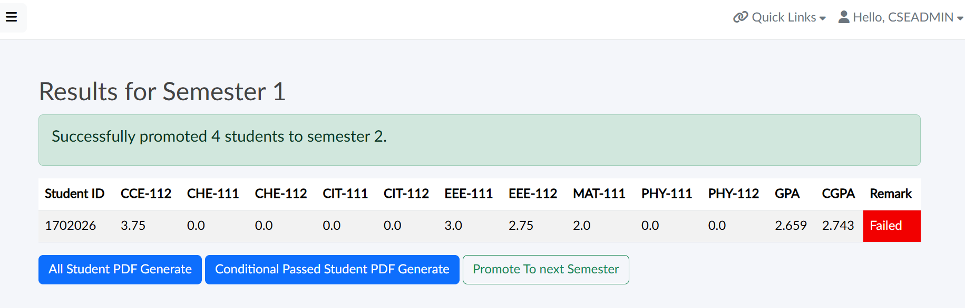
Next Semester Promotion

Slide 17
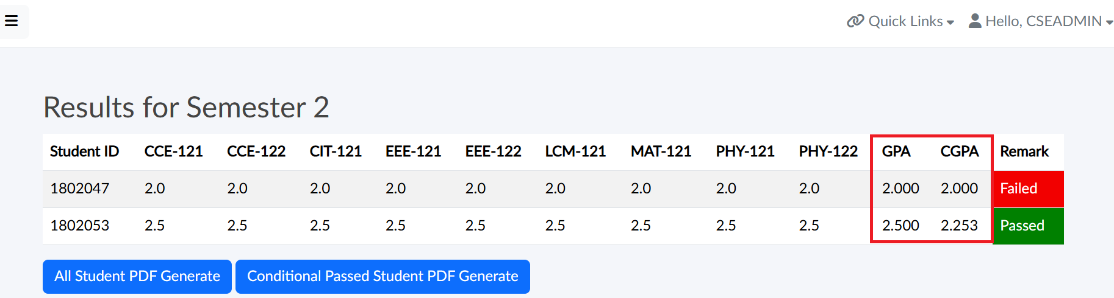
Regular Period: Minimum GPA 2.00 and CGPA 2.25 – (Clause: 18.1.1)

Slide 18
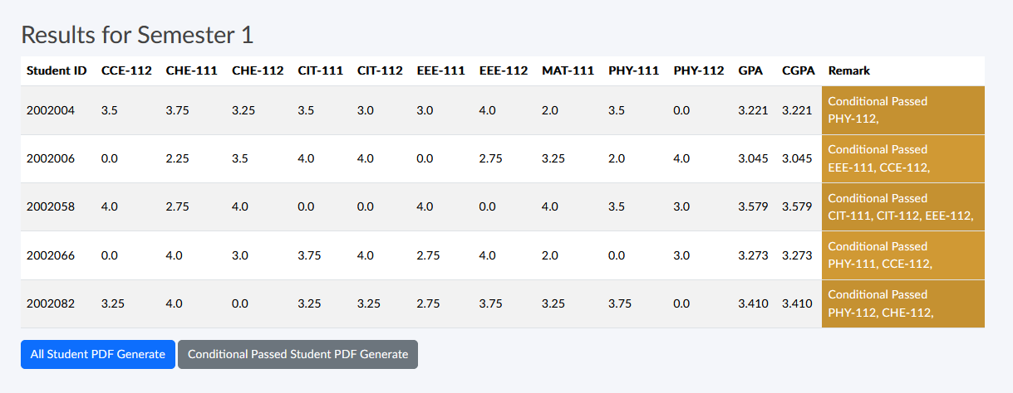
Regular Period: Minimum GPA 2.00 and CGPA 2.25 – (Clause: 18.1.1)

Slide 19
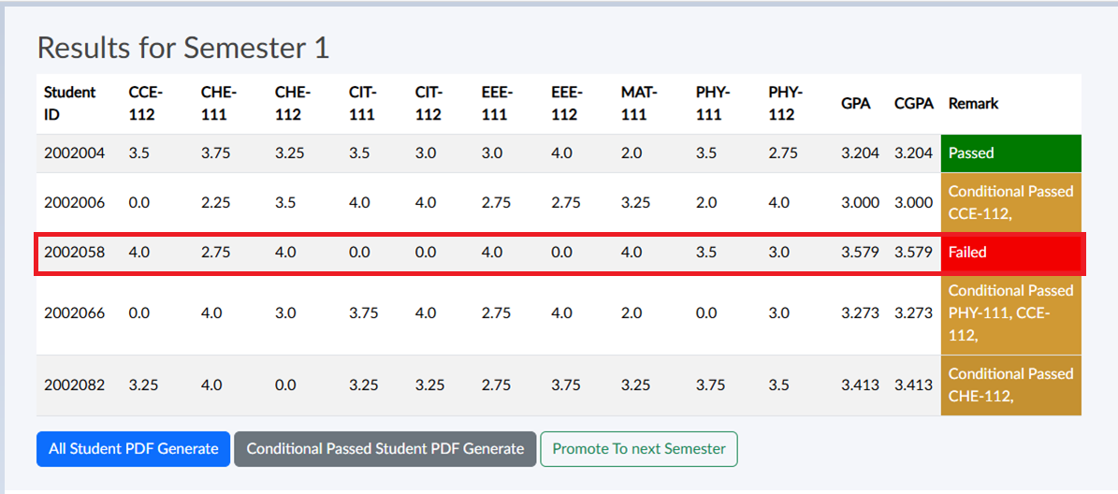
F-Removal Period: Minimum GPA 2.00 and CGPA 2.25 – (Clause: 18.1.1)

Slide 20
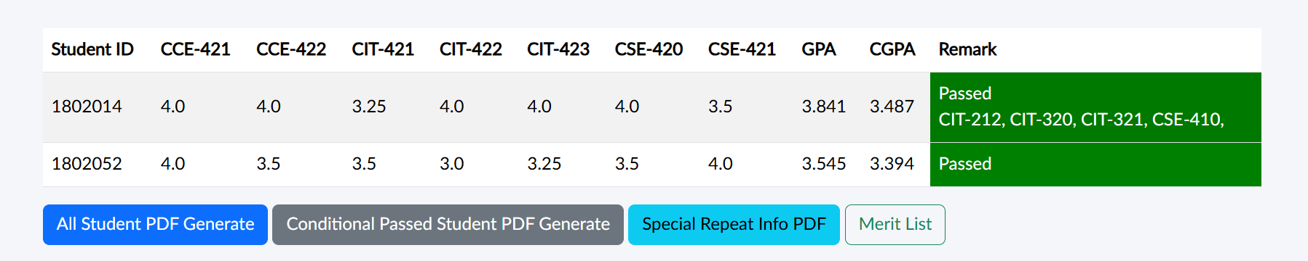
After Special Repeat

Slide 21
Thank you

